Slide 1
Statisticians
In the loop
Reimagining the Statistician for the Age of AI
The 7th ISM International Statistical Conference 2025
28.08.2025

Slide 2



Chiung Ching Ho
Senior Data Scientist peyter@gmail.com
All ideas and opinions shared in the keynote address are the author’s alone, and is not representative of Bank Negara Malaysia or any officer related to Bank Negara Malaysia

Slide 3
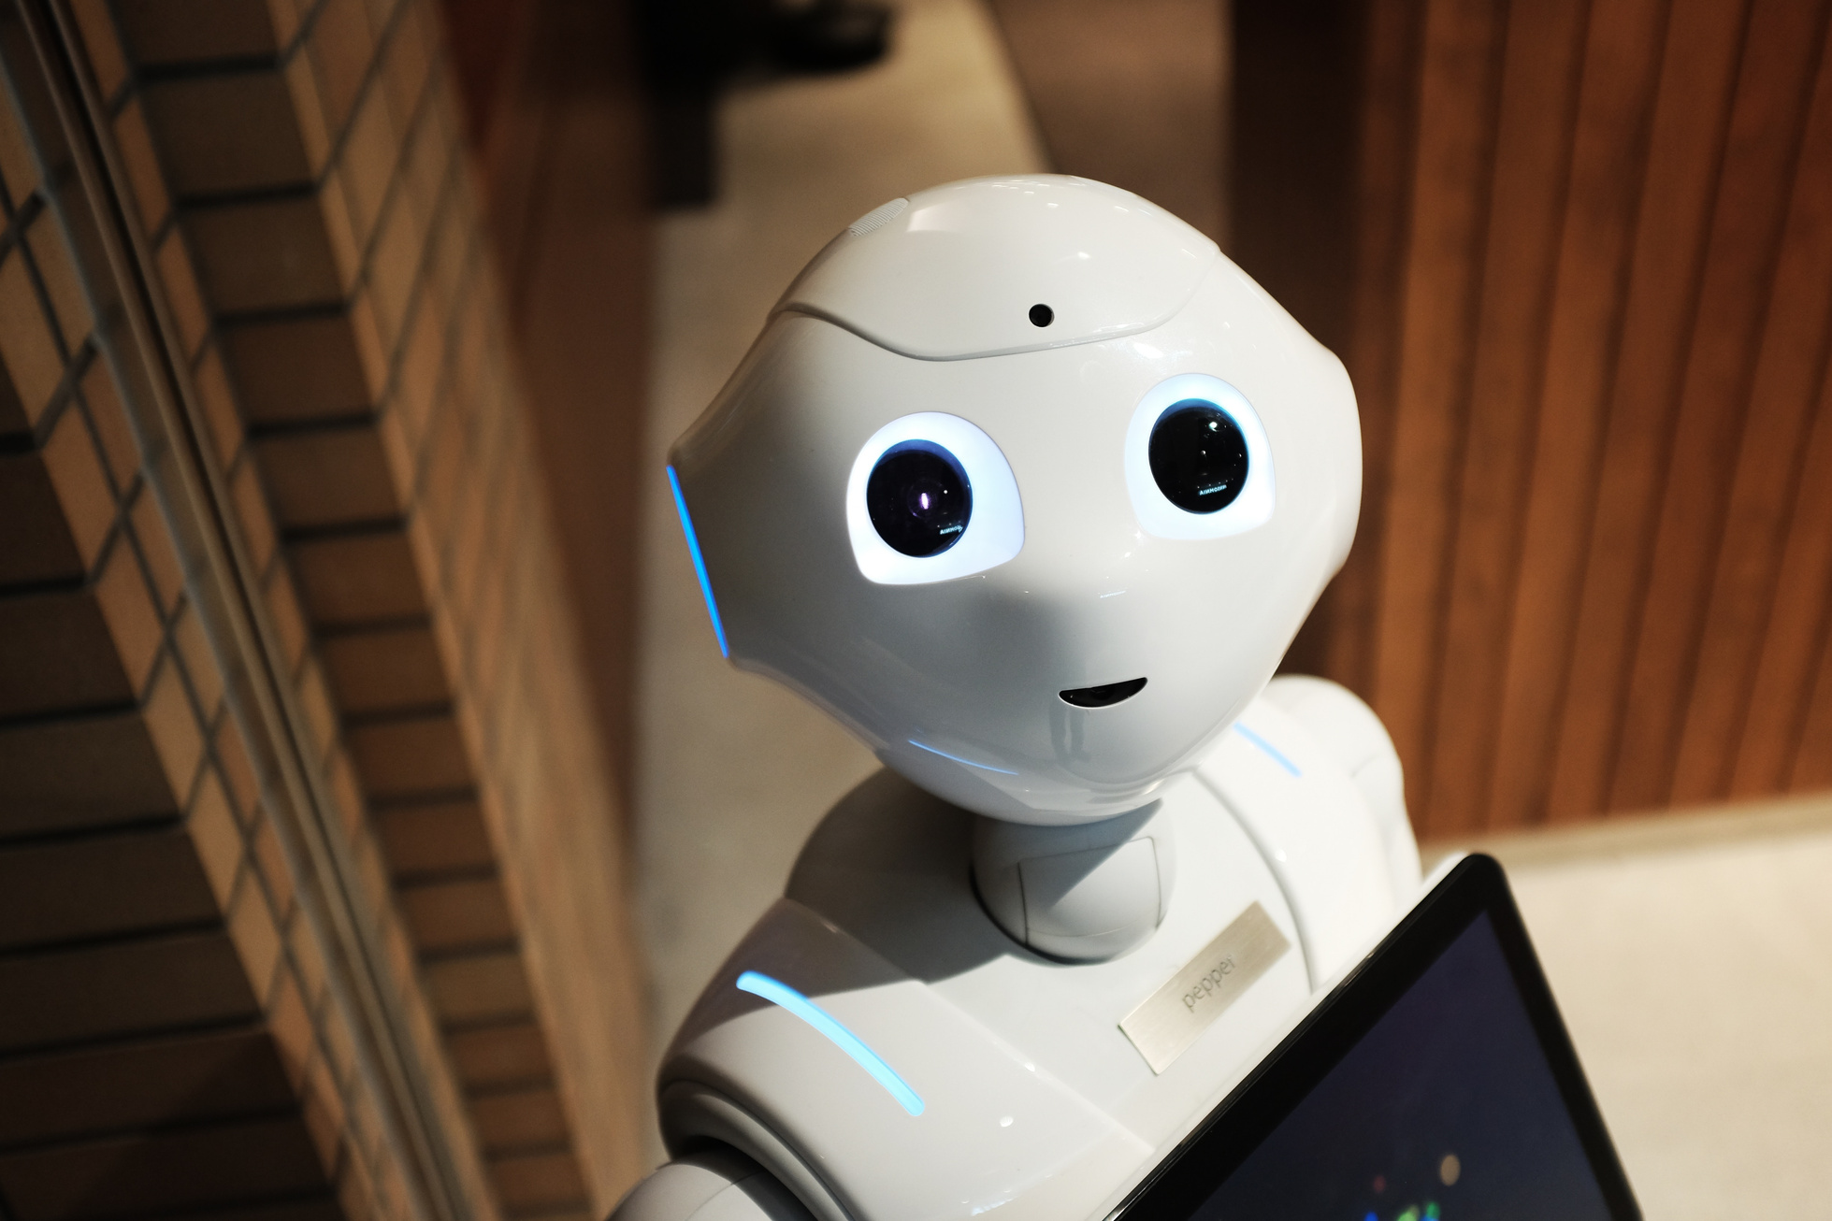
The Challenge!
Trading accuracy for less Bias
Metric | Statistician in the Loop | Pure AI | Winner
Accuracy (R²) | 0.263 | 0.275 | AI
Gender Bias ($) | $39 | $11,036 | Human
Racial Bias ($) | $32,113 | $26,009 | AI
Interval coverage | 89.9 | 89.9 | Tie
Transparency | High | Black-box | Human
 | We traded 4.4% accuracy for a 99.6% gender bias reduction (although race bias increased by 23.46% ) while maintaining statistical rigor. Conformal prediction coverage affirmed that the basic gaussian distribution assumption of the Bayes model is true

Slide 4

Is Artificial Intelligence
coming for the statistician’s
Job? (Ho,2025)
YES
NO

Slide 5
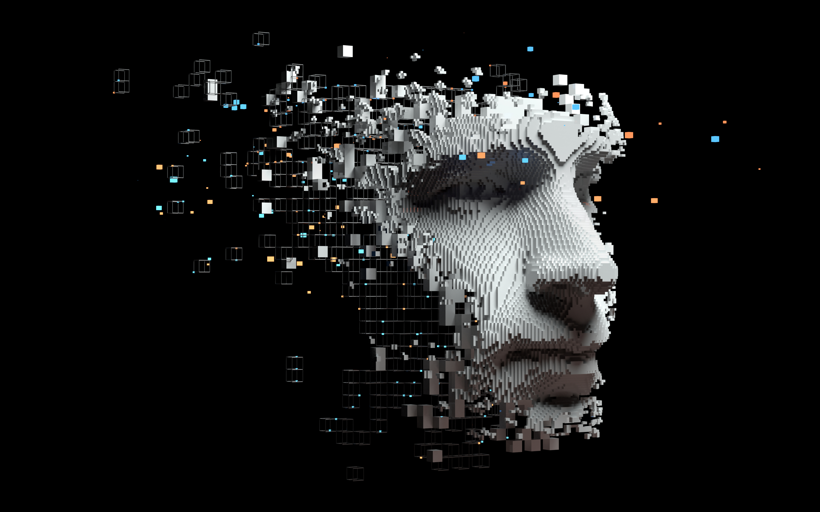
AI is NOT the End of our Statistical profession
It’s the signal for statisticians to evolve
 | AI can detect patterns in millions of variables and automate tasks.
 | The real question is: "What does it mean to be a statistician when machines can do statistics?".
 | This is a new partnership, not a battle.
 | Introducing the Statistician in the Loop concept.

Slide 6
The Irreplaceable Human Element
The Statistician in the Loop
 | AI finds answers; statisticians ask the right questions.
 | We quantify uncertainty, understand bias, and establish causality.
 | We also ensure that the data collection and dissemination methodology is sound
 | Statisticians ensure that AI is not feed garbage data!

Slide 7
Problem Statement
And
Data
Annual income information from survey may be laggy. What if we wanted to predict income using predictors such as age, education levels, hours worked per week, gender and race?
01
02
PUMS (Public Use Microdata Samples) is the U.S. Census Bureau's detailed individual and household-level dataset from the American Community Survey (ACS).
PUMS has rich demographic detail: Each person record includes: Demographics (age, sex, race, education)Economic variables (income, hours worked, occupation, industry), Geographic identifiers (state, PUMA - areas of 100,000+ people) and Survey weights for population representation

Slide 8
Three AI agents guided by human decisions.
The Statistical Feedback Agent detects systemic bias in the PUMS income data, requiring human statisticians to choose between documenting reality (using all variables) or applying fairness constraints (excluding protected attributes such as gender and race) - an ethical judgment AI cannot make.
01
Presentations are communication tools that can be used as demonstrations, lectures, speeches, reports, and more. It is mostly presented before an audience.
Forecast uncertainty combines two methods working with the same features.
Bayesian Ridge regression provides income predictions with model uncertainty, while Conformal Prediction creates guaranteed coverage intervals (e.g., "90% will contain true income") regardless of model assumptions.
02
Methodology
Presentations are communication tools that can be used as demonstrations, lectures, speeches, reports, and more. It is mostly presented before an audience.
The system demonstrates why human expertise remains essential. While AI agents detect bias and quantify uncertainty, only human statisticians can make critical value judgments about fairness trade-offs and interpret results contextually, showing AI should amplify rather than replace statistical expertise.
03
Presentations are communication tools that can be used as demonstrations, lectures, speeches, reports, and more. It is mostly presented before an audience.
Focus is on the gender wage gap (median income) and race wage gap (% delta between highest and lowest wage by race). Systemic gender and race wage bias is documented in literatures such as 6.
Notes:
race_gap = (white_income - black_income) / black_income * 100 if black_income > 0
Gap=Median(Female)Median(Male)−Median(Female)​×100

Slide 9
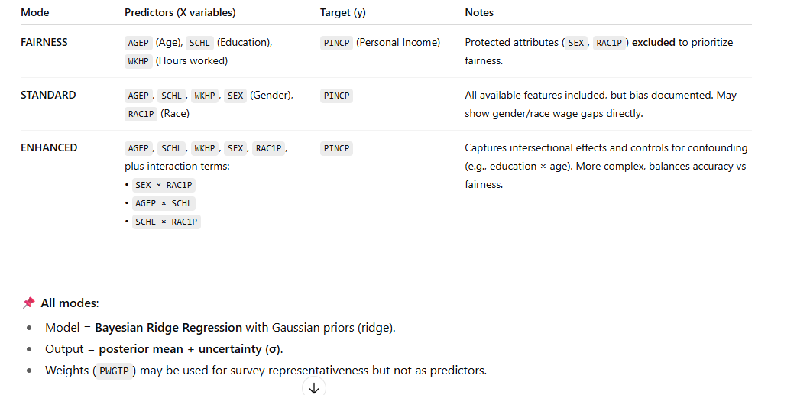
Methodology
Focus is on the gender wage gap (median income) and race wage gap (% delta between highest and lowest wage by race). Systemic gender and race wage bias is documented in literatures such as 6.
Notes:
race_gap = (white_income - black_income) / black_income * 100 if black_income > 0
Gap=Median(Female)Median(Male)−Median(Female)​×100

Slide 10
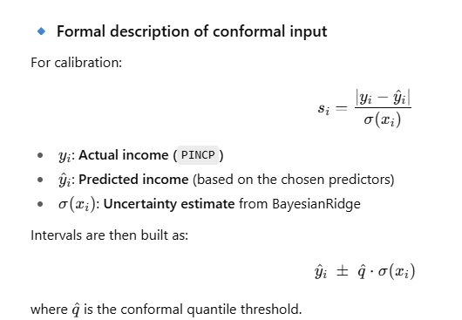
Methodology
Focus is on the gender wage gap (median income) and race wage gap (difference between highest and lowest wage by race). Systemic gender and race wage bias is documented in literatures such as 6.
Notes:
The job of the conformal quantile threshold (q^\hat{q}q^​):
It’s a safety factor that tells us how much bigger the prediction intervals need to be so that we really capture the true values about 90% of the time.
How it works:
Check past mistakes
Look at a set of calibration data.
Compare each prediction to the real answer.
Measure: how far off was the model compared to how confident it said it was?
Find the “worst-case” typical error
Sort those errors from smallest to largest.
Pick the error value that leaves only 10% of cases above it (for 90% coverage).
This value = q^\hat{q}q^​.
Use it as a multiplier
Future prediction intervals = model’s predicted value ± q^×\hat{q} \times q^​× model’s own uncertainty.
If the model is usually right, q^\hat{q}q^​ is close to 1.
If the model is often too confident, q^\hat{q}q^​ might be 2 or 3 — widening the bands.

Slide 11
Statistician in the Loop : The method
 | AI finds answers; statisticians ask the right questions.
 | Step 1: Bias Detection: The Statistical Feedback Agent flags multiple sources of bias in the data, including a 25% median gender gap and 75.8% income gap between racial groups
 | Step 2: Human Decision Point #1: The statistician decides how to handle the detected bias (e.g., apply fairness constraints).
 | Step 3: Fair Model: A fairness-aware model is built using only age, education level and hours worked per week while excluding gender and race
 | Step 4: Conformal Prediction: Conformal provides distribution-free prediction intervals version of the Bayesian model to test the Bayesian assumptions

Slide 12
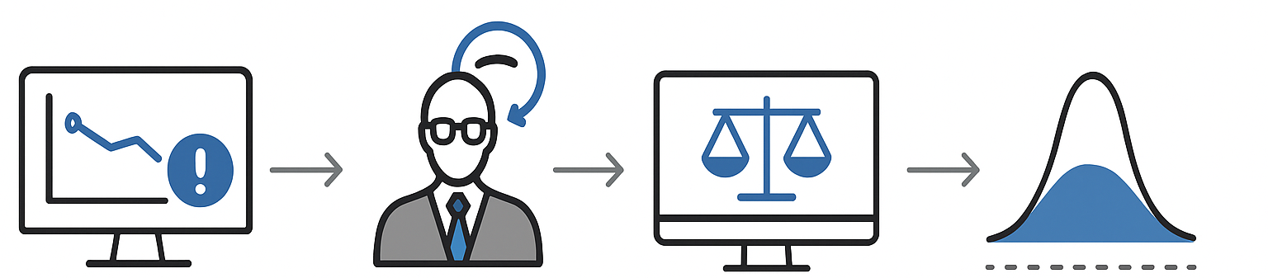
Statistician in the Loop interacting with Agents
Bias
Detecting
Agent
Statistician-in-the- Loop
Decision
Point
Bayes Agent
Conformal
Prediction
Agent
Implemented using the AG2 library , which is powered by hosted LLM or by local LLM such as Ollama

Slide 13
The Challenge!
Trading accuracy for less Bias
Metric | Statistician in the Loop | Pure AI | Winner
Accuracy (R²) | 0.263 | 0.275 | AI
Gender Bias ($) | $39 | $11,036 | Human
Racial Bias ($) | $32,113 | $26,009 | AI
Interval coverage | 89.9 | 89.9 | Tie
Transparency | High | Black-box | Human
 | We traded 4.4% accuracy for a 99.6% gender bias reduction (although race bias increased by 23.46% ) while maintaining statistical rigor. Conformal prediction coverage affirmed that the basic gaussian distribution assumption of the Bayes model is true

Slide 14
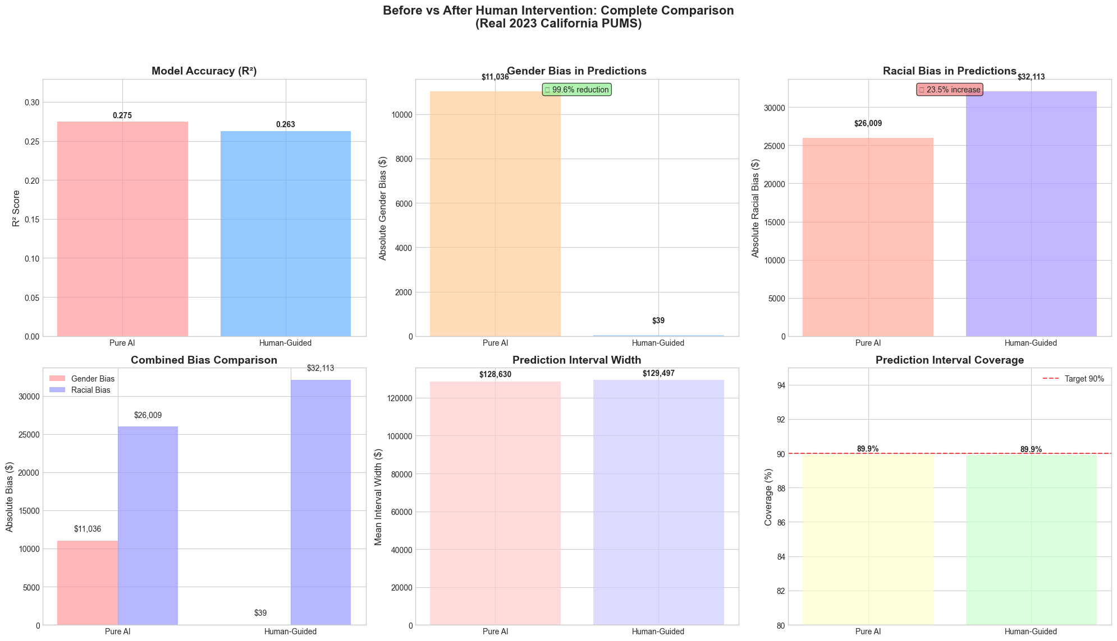
Statistician in the Loop: The effect
Notes:
Accuracy is goodness to fit for annual salary using the various variable
Gender bias is absolute $ term median income delta by gender
Racial bias = absolute difference in median predicted incomes between White and Black groups (in $).
Prediction interval width is huge due to perhaps bayes uncertainty estimate are inflated Prediction internal coverage = 90 % of true income fall within the prediction interval

Slide 15
The wisdom of asking the right questions
Case studies
 | #1 AI achieves 95% accuracy in predicting job performance.
 | A statistician asks about fairness, protected characteristics, and the definition of "performance".
 | #2 AI identifies a novel biomarker.
 | A statistician asks about clinical significance, trial design, and ethical implications.

Slide 16
The Art of Causal Thinking
Correlation Isn't Causation
 | AI excels at correlation.
 | Causation is our domain: we control for confounding variables, design experiments, and understand causal inference.
 | Example: An AI predicts email marketing increases spending, but a statistician designs a randomized experiment to prove it.

Slide 17
Beyond Accuracy: The Illusion of Accuracy
Remember Simpson’s Paradox
 | AI obsesses over single-point accuracy metrics.
 | A deeper statistical understanding is needed to avoid misleading metrics like Simpson's Paradox.
 | Simpson Paradox - when a trend that appears in aggregate data reverses (or disappears) when the data is broken into subgroups.
 | California PUMS analysis example: An accurate model can still have a significant income bias against women and certain racial groups.

Slide 18
The Quest for Uncertainty
Are you sure?
 | AI models are often overconfident, defaulting to point estimates without measures of certainty.
 | Statisticians provide crucial context with honest prediction intervals.
 | PUMS analysis example: Using conformal prediction, we provide wide intervals for uncertain predictions (e.g., low-income households) and narrow ones for confident predictions (e.g., high-income professionals).

Slide 19
Garbage In, Garbage Out?
Data quality matters
 | A sophisticated neural network is useless if trained on biased data.
 | A trained statistician will be aware of biases introduced by Sampling weights, due to sampling design Temporal bias, e.g. inflation rate or currency exchange rate at a given time Spatial bias, which may perpetuate historical biases

Slide 20
The AI-enabled Statistician's Toolkit
Tooling for the AI-enabled
 | Statisticians may need to move away from proprietary statistics software such as Matlab, Stata, SPSS…
 | Programming languages such as Python and R has rich support for statistical test
 | The core of machine learning is built on statistical theory: regression, hypothesis testing, PCA, and Bayesian methods.

Slide 21
The New Frontier: Interpretability and Fairness
SHAP
 | Interpretability is possible due to tools such as SHAP
 | Fairness is also measurable , using measures such as demographic parity and equal class distribution across groups
 | Often a balancing act between allocation fairness (who gets the benefit) versus classification accuracy fairness (equal error rates) versus calibration fairness (equal meaning of scores)
Notes:
Demographic Parity (Statistical Parity) P(Ŷ = 1 | A = 0) = P(Ŷ = 1 | A = 1)
Where Ŷ is predicted outcome and A is protected attribute. This requires equal positive prediction rates across groups - essentially testing independence between predictions and group membership.

Slide 22
01
Learn R and Python. And if you know R and Python, pick up agentic coding to scale up analytics throughput
Call to action
02
Download and explore the California PUMS data.
03
Implement manual conformal prediction to understand uncertainty.
Work with GenAI

Slide 23
Statisticians in the Loop
01
The future needs more than faster algorithm or ‘vibed statistics’Vs
The future needs scrutiny, wisdom and fairness
02
Is a ‘best of both world’ scenario where AI assisted statistical analysis possible?
YES, but only if Statisticians are actively engaged in the analytic workflow
Roles to play as Statisticians in the Loop
The Validator: We move beyond simple accuracy.
The Uncertainty Quantifier: We turn guesses into responsible risk assessments.
The Causal Inferrer: We separate real impact from random noise.
The Ethicist: We are the front line against algorithmic bias.
03

Slide 24
The future of data analysis can involve great progress, the overcoming of real difficulties, and the provision of a great service to all fields of science and technology (Turnkey, 1962)
Notes:
John Tukey's 1962 prediction of data analysis's future.
The modern anxiety about AI's impact on the statistics profession.
Reframing the question from "if" to "how" our jobs are changing

Slide 25

Demo

Slide 26
Demo
Lengthier

Slide 27
AI can predict neuroscience study results better than human experts
Olympiad geometry problem solving using AI
Accelerating research with an AI co-scientist
Mathematicians question ai performance at international math Olympiad
Causal Inference Meets Deep Learning: A Comprehensive Survey
Double Jeopardy? The Interaction of Gender and Race on Earnings in the U.S
References
Full reproducible notebooks can be found at https://github.com/pengkodam/ISM-VII2025

Slide 28
BACK
The evidence for
AI displacement of statisticians
01
02
03
Large language models (LLM) can predict the results of proposed neuroscience studies more accurately than human experts, finds a study led by University College London (UCL) researchers [1]
AlphaGeometry, an AI system that solves complex geometry problems at a level approaching a human Olympiad silver-medalist , solving 25 within the standard Olympiad time limit. The average human gold medalist solved 25.9 problems.[2]
Google’s AI co-scientist system is intended to uncover new, original knowledge and to formulate demonstrably novel research hypotheses and proposals, building upon prior evidence and tailored to specific research objectives.[3]

Slide 29
BACK
The counter evidence that AI will displace statisticians
01
02
03
The authors of the UCL paper on neuroscience prediction added a disclaimer alluding that “This success suggests that a great deal of science is not truly novel, but conforms to existing patterns of results in the literature.” This hints that AI still struggle at novel discoveries [1]
Mathematicians, including Terrence Tao (a former International Maths Olympiad gold medalist) alluded that the Maths Olympiad did not prepare him well for the kind of deep research needed for novel mathematical breakthroughs. [4]
Existing AI models are able to learn using correlation in the date but are unable to perform causal inference of the same data. Hence, out-of-sample causations are not captured well. To make the problem worse, natural language encodes human biases, masking true causation from spurious causations [5]

